Slide 1
EN 410 Energy Management
Gurubalan Annadurai
guru.a@iitb.ac.in

Slide 2
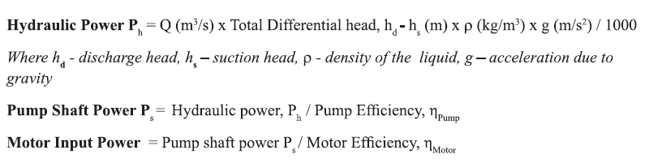
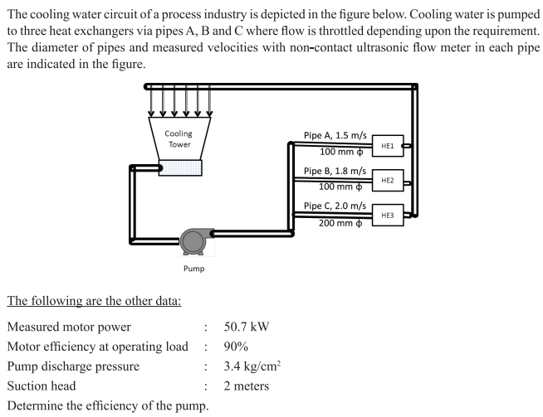
Pump performance parameters

Slide 3
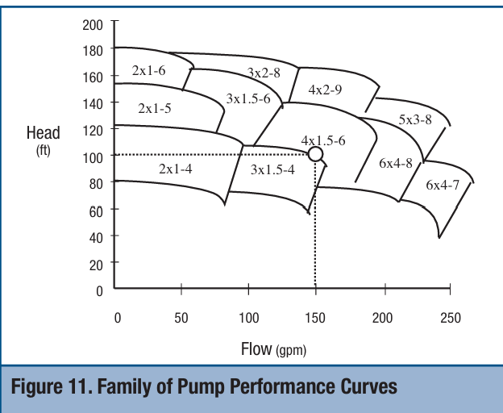
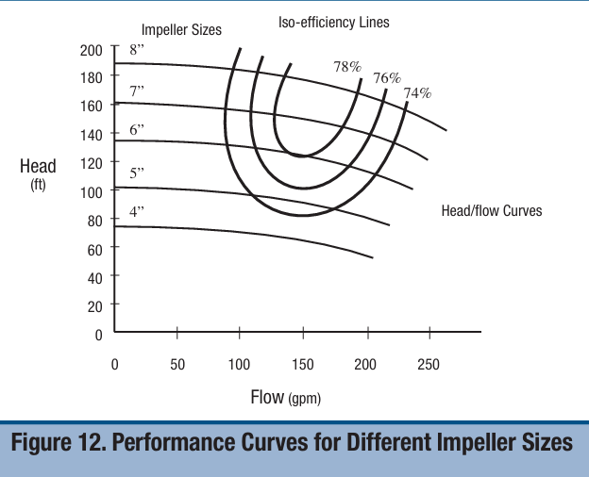
Pump selection curve

Slide 4
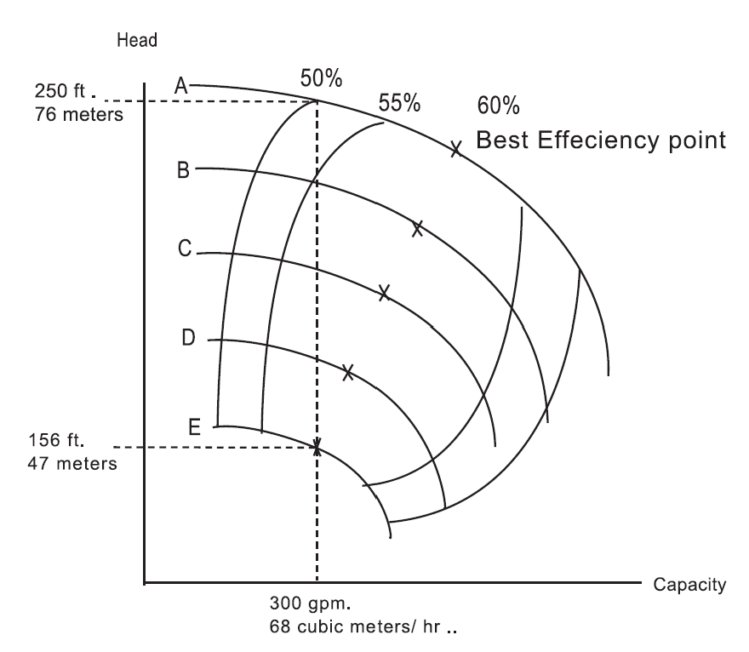
Effect of oversized pump
What happened if we select A instead of E?
Pump cost of E is INR 300000
Operating hours = 8000 hrs./year
Utility rate = INR 5.5/kWh
Motor efficiency = 90%
Density of water = 1000 kg/m³

Slide 5
Pump Control Strategies
Often Oversizing – Does not operate at Design point
Bypass Control
Throttling
Variable Speed Drives
Trimming Impeller (reducing Diameter)

Slide 6
Bypass control
Pump runs continuously at the maximum process demand level, with a permanent bypass line attached to the outlet.
When a lower flow is required, the surplus liquid is bypassed and returned to the supply source.

Slide 7
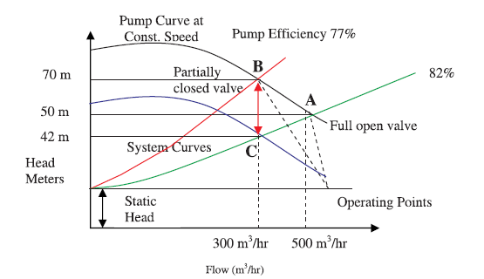
Valve control method

Slide 8
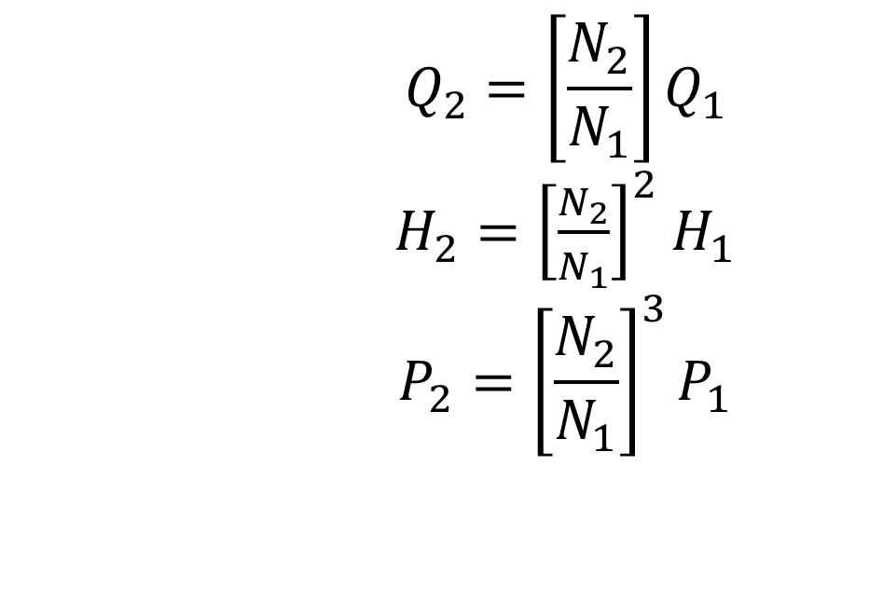
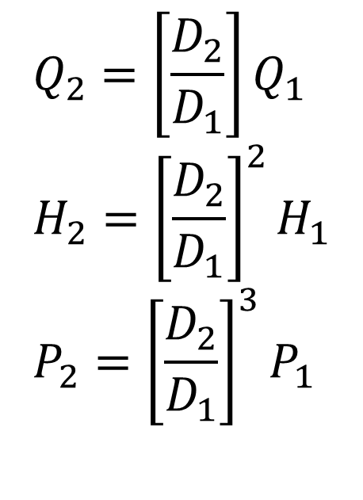
The Affinity Laws
$$Q_{2}=\left[\frac{D_{2}}{D_{1}}\right]Q_{1} \\ H_{2}={\left[\frac{D_{2}}{D_{1}}\right]}^{2}H_{1} \\ P_{2}={\left[\frac{D_{2}}{D_{1}}\right]}^{3}P_{1}$$
$$Q_{2}=\left[\frac{N_{2}}{N_{1}}\right]Q_{1}$$ $H_{2}={\left[\frac{N_{2}}{N_{1}}\right]}^{2}$ $H_{1}$ $$P_{2}={\left[\frac{N_{2}}{N_{1}}\right]}^{3}P_{1}$$

Slide 9
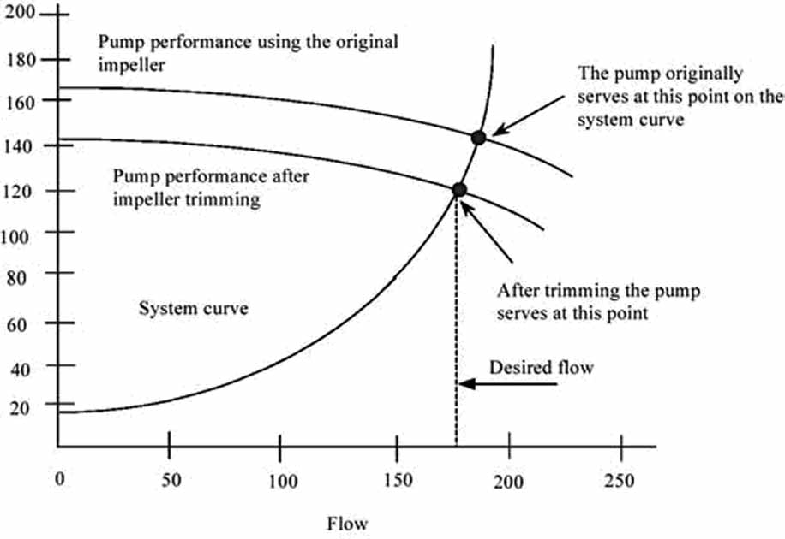
Impeller trimming to reduce flow
Permanent changes
Impeller diameters are rarely reduced below 70% of their original size

Slide 10
Pump speed adjustments
Multiple-speed pump motors and variable speed drives (VSDs)
Multiple-speed motors: different set of windings for each motor speed
Expensive, less efficient, discrete speeds
Mechanical VSDs: hydraulic clutches, fluid couplings, and adjustable belts and pulleys.
Electrical VSDs: eddy current clutches, wound-rotor motor controllers, and variable frequency drives (VFDs)

Slide 11
Speed control
A centrifugal pump, pumping water operates at 35 m³/h and at 1440 RPM. The pump operating efficiency is 68% and motor efficiency is 90%. The discharge pressure gauge shows 4.4 kg/cm². The suction is 2 m below the pump centerline. If the speed of the pump is reduced by 50% estimate the new flow, head and power.
Original Modified
flow:
head:
power:

Slide 12
Speed control
A centrifugal pump, pumping water operates at 35 m³/h and at 1440 RPM. The pump operating efficiency is 68% and motor efficiency is 90%. The discharge pressure gauge shows 4.4 kg/cm². The suction is 2 m below the pump centerline. If the speed of the pump is reduced by 50% estimate the new flow, head and power.
Original Modified
flow: 35 m³/h 17.5 m³/h
head: 46 m 11.5 m
power: 7.17 kW 0.9 kW

Slide 13
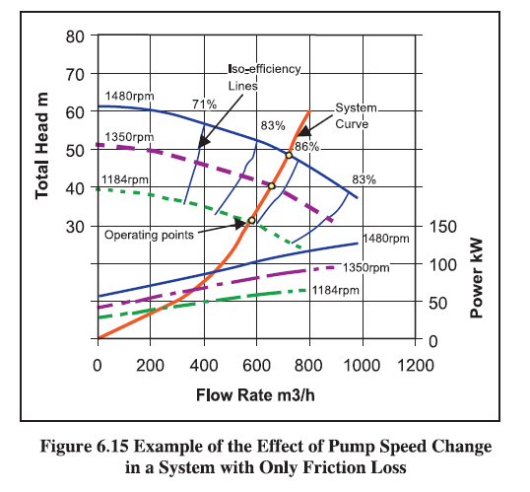
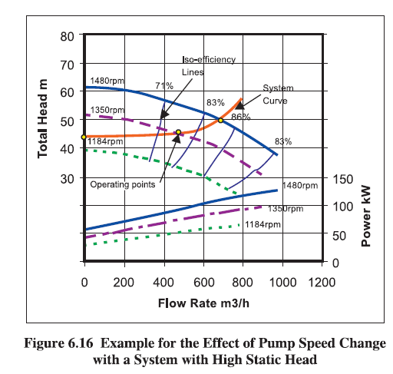
Speed Control

Slide 14
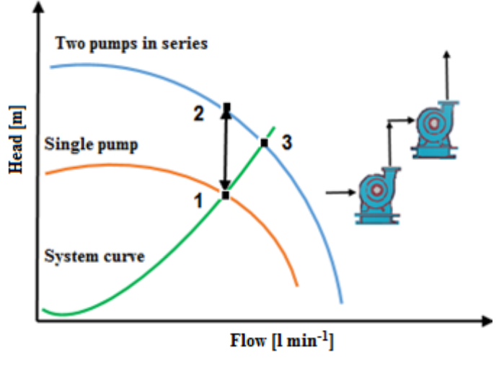
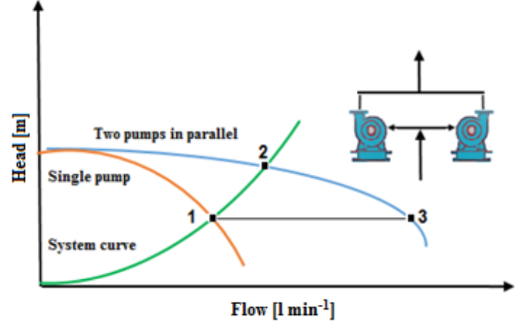
Pumps in Series/Parallel

Slide 15
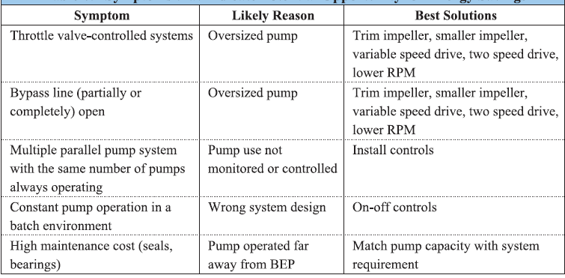
Symptoms for energy efficient operation

Slide 16
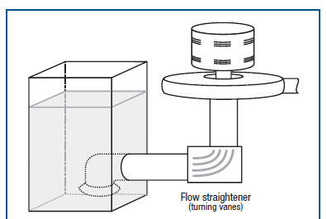
Piping arrangements

Slide 17
References
https://www.energy.gov/sites/prod/files/G_Overview_of_Pump_Systems_Matter.pdf
https://blog.craneengineering.net/pumps-dont-suck-and-other-centrifugal-pump-basics
https://marinersgalaxy.com/what-is-reciprocating-pump-and-how-i/
https://pumpsdesign.com/system-characteristic-curve/
https://www.springerpumps.com/productnews/npsh-net-positive-suction-head-matters/
https://www.energy.gov/sites/prod/files/2014/05/f16/pump.pdf
https://actamont.tuke.sk/pdf/2018/n2/3qazizada.pdf

